Slide 1









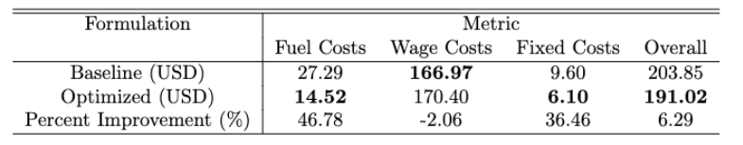


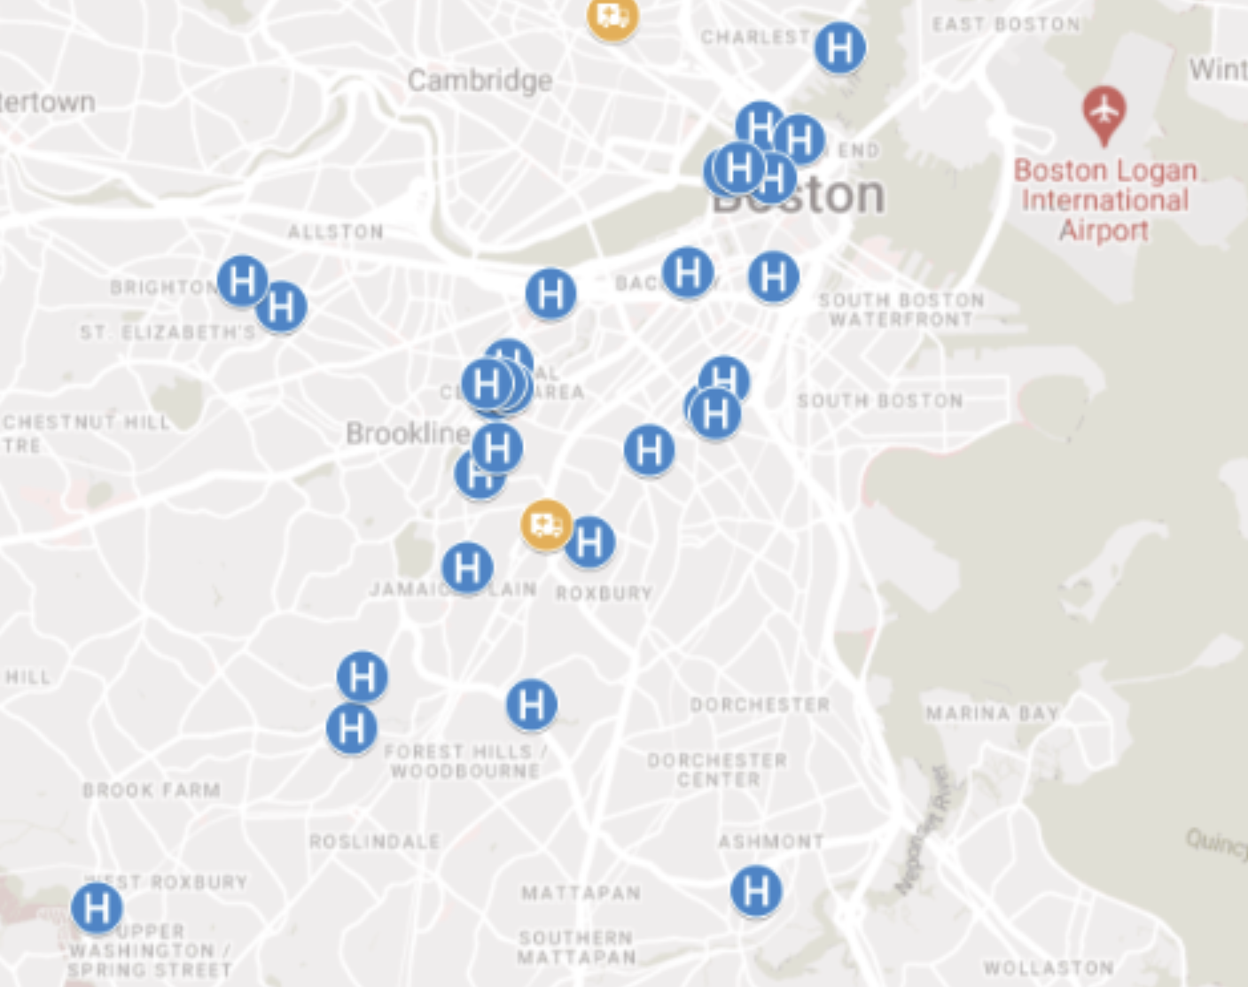





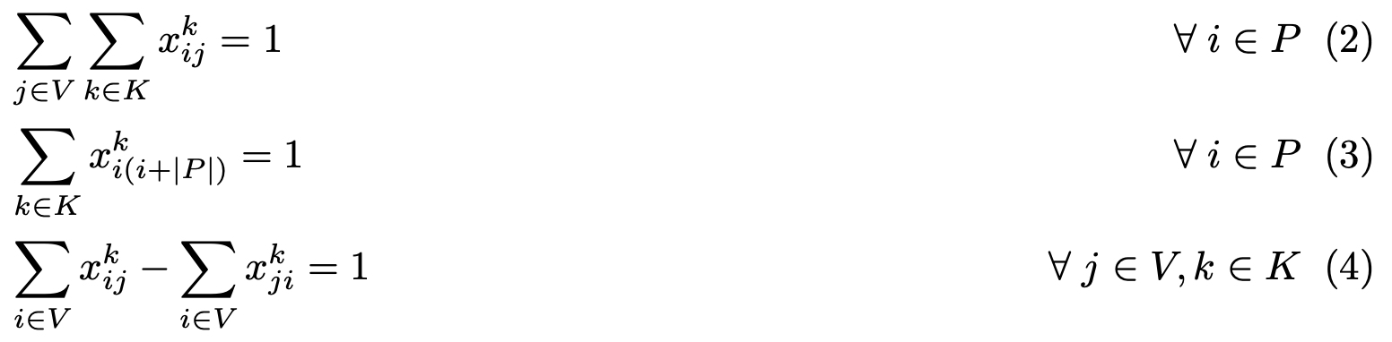
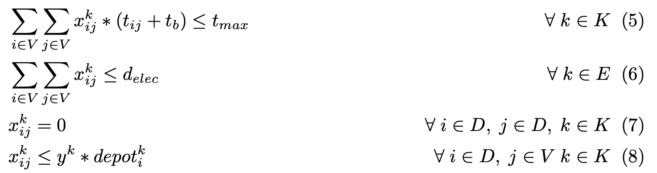


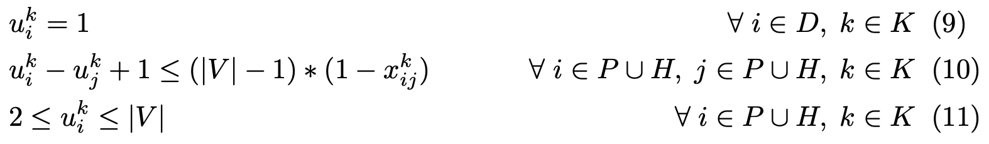
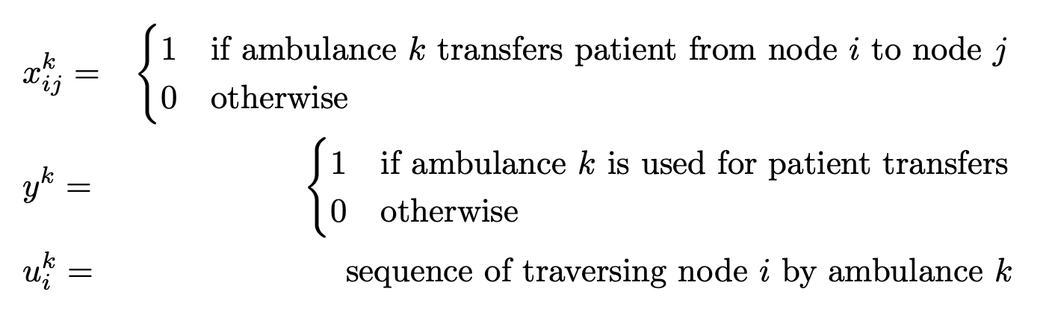




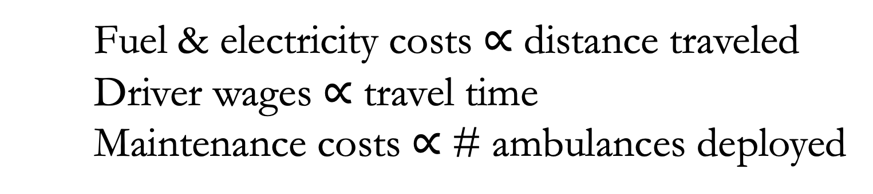
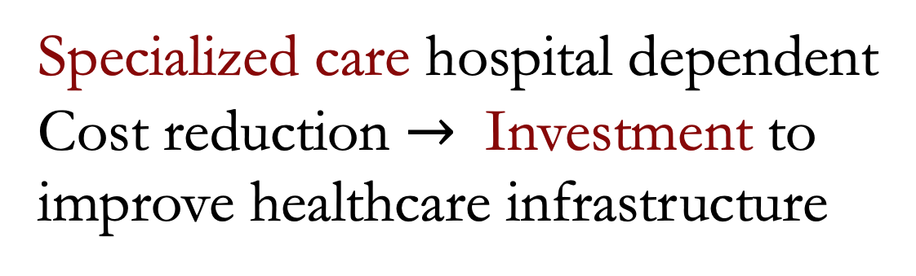

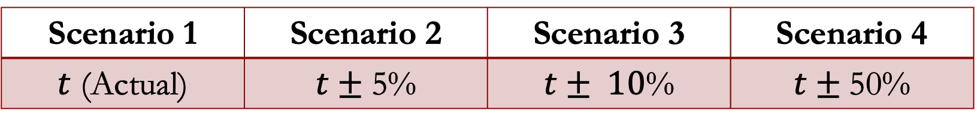
Optimizing inter-hospital patient transfer (IHT) routing
Max Petruzzi (MBAn)
Rachit Jain (MBAn)
Executive Summary
Data
Flavor of Robustness
46.8%
fuel cost reduction
Go Electric!
Extracted Data
Processed Data
Scenario 1 | Scenario 2 | Scenario 3 | Scenario 4
$t$ (Actual) | $t±$5% | $t± 10$% | $t±$50%
over real-world baseline
More Distances; Less Cost
Coordinates of hospitals
# Staffed beds
$/mi for Fuel (ICE) & EV
Distance & Time
(TravelTime API)
Added traffic scenarios; uniformly averaged for robust route
Realistic
Interpretable
Robust
Results & Impact
Problem Statement
Intelligently Synthesized Data
Fictional patient transport company based in Boston
Given: Pre-determined demand of patient transfers
Goal: Optimize multi-ambulance routing and vehicle type to minimize direct costs to the company
Patient transfer demand $∝$ staffed beds
Vehicle maintenance cost & driver wages
Mixed Integer Formulation
Baseline based on current standard practice
Ambulances at central “regions” + real-time dispatch
Multi-Objective
?
Geographical Visualizations
?
Flow Constraints
Bounds & Linking Constraints
Optimal routes available on interactive webpage for interpreting model output
QR Code
Fuel & electricity costs $∝$ distance traveled
Driver wages $∝$ travel time
Maintenance costs $∝$ # ambulances deployed
Scope of Improvement
Sequence Constraints
Decision Variables
Scaling up the problem with duality techniques
Quantify emission reduction with minimization of Total distance traveled & Utilization of EV
Allowing ambulances to start and end at different depots, incorporating notion of depot capacity
Adding time windows based on patient availability
Priority variable for emergency or special needs
Motivation
1.3M
inter-hospital transfers/year
Specialized care hospital dependent
Cost reduction $→$ Investment to improve healthcare infrastructure
(3.5% of net admissions)
Key Features
Key Additions
5 mins
2X
Multi-Depot
Gas Ambulances vs EVs
Sequenced Outputs
Driver travel constrained by 8hrs
EV ambulances travel less than 60mi in one charge
Survival Rate
Ambulance Response Time
Cardiac arrests not witnesses
15.071—The Analytics Edge Fall 2019
15.093 | Optimization Methods
Fall 2022

